Slide 1
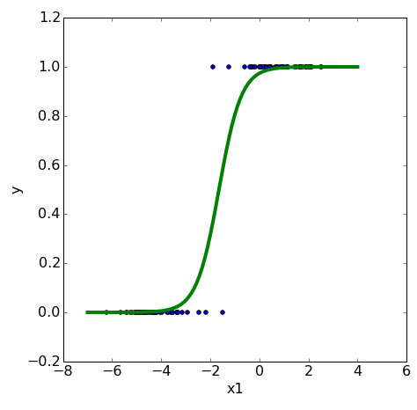

A quick recap on logistic regression
More inputs,
More parameters
Notes:
For classification, logistic regression replaces the direct linear output by a non-linear transformation, typically a sigmoid. The model still computes a weighted sum of the inputs, but then maps that score to a probability-like output between 0 and 1. This makes logistic regression suitable for binary classification.

Slide 2
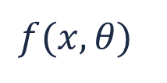
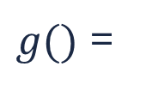
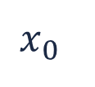
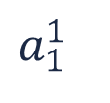
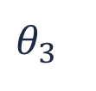
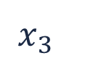
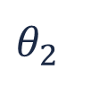
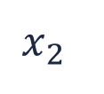
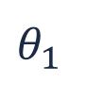
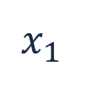
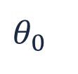
Logistic regression could be visualized as a network of information, flowing from features and weights to the output
$$x_{0}$$
$$θ_{0}$$
$$x_{1}$$
$$θ_{1}$$
$g()$ =
$$a_{1}^{1}$$
$$f(x,θ)$$
$$θ_{2}$$
$$x_{2}$$
$$θ_{3}$$
$$x_{3}$$
weights
features
logistic regression
Notes:
Logistic regression can be viewed as a very small network: input features are multiplied by weights, summed together with a bias, and passed through an activation function to produce the output.
This viewpoint is useful because it shows that neural networks are not completely new models, but rather structured combinations of simpler regression-like units.

Slide 3
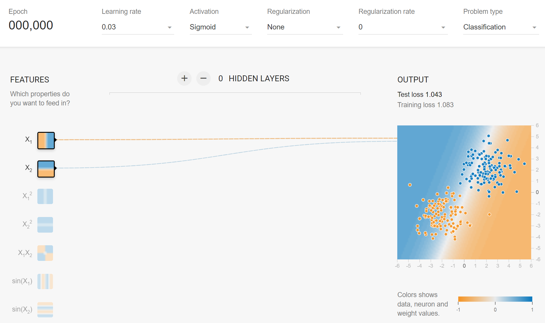
Logistic regression could be visualized as a network of information, flowing from features and weights to the output

Slide 4
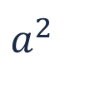
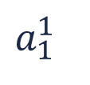
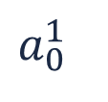

A neural network is simply a layered stack of regression models
The features for each node (a regression model) are the output from the nodes in the previous layer
$$x_{0}$$
$$x_{1}$$
$$a_{0}^{1}$$
$$a^{2}$$
$$f(x,θ)$$
$$x_{2}$$
$$a_{1}^{1}$$
$$x_{3}$$
features
hidden layer(s)
output layer
Notes:
A neural network is a layered stack of such units. The first layer receives the original input features. Each node in a hidden layer computes a transformed version of the previous layer’s outputs. The next layer then uses those transformed outputs as its own inputs. In this way, the network builds increasingly abstract internal representations of the data.

Slide 5
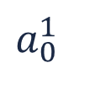
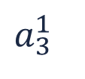
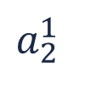

A neural network is simply a layered stack of regression models
The features for each node (a regression model) are the output from the nodes in the previous layer
$$x_{0}$$
$$a_{0}^{1}$$
$$x_{1}$$
$$a_{1}^{1}$$
$$a^{2}$$
$$f(x,θ)$$
$$x_{2}$$
$$a_{2}^{1}$$
$$x_{3}$$
$$a_{3}^{1}$$
…
features
hidden layer(s)
output layer
Notes:
A shallow neural network contains one hidden layer. A deeper neural network contains multiple hidden layers. Adding layers allows the model to capture more complex patterns than a single logistic regression can represent.

Slide 6
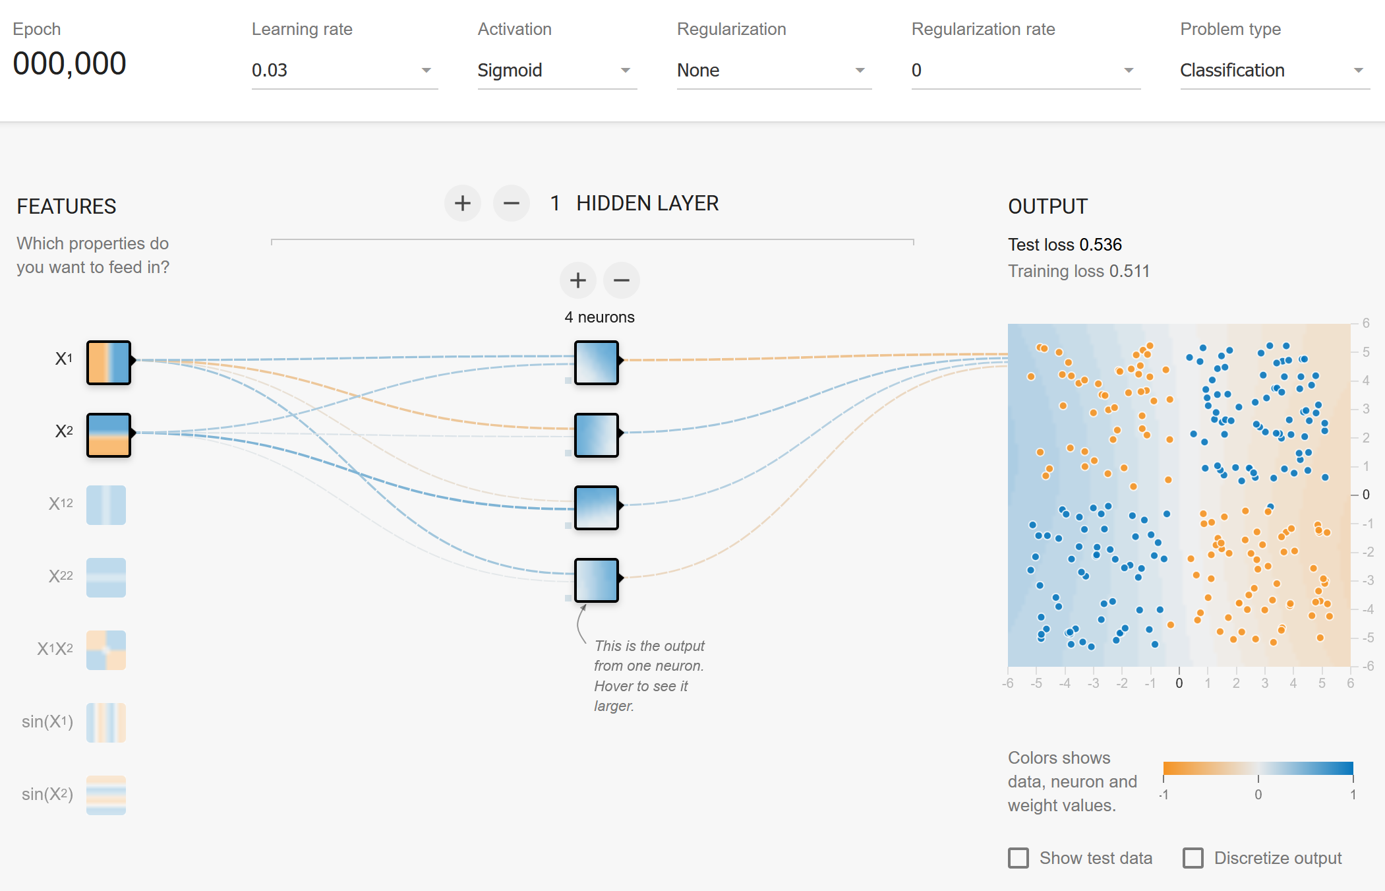
A neural network is simply layered stacks of logistic regressions

Slide 7

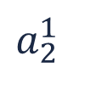
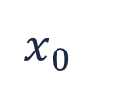
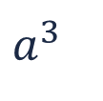

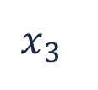
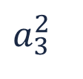
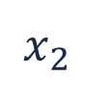
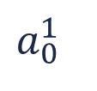
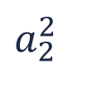
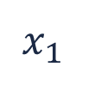
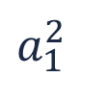
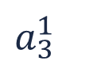
A deep neural network adds many layers to capture complex patterns
$$x_{0}$$
$$a_{0}^{1}$$
$$a_{1}^{2}$$
$$x_{1}$$
$$a_{1}^{1}$$
$$a_{2}^{2}$$
$$a^{3}$$
$$f(x,θ)$$
$$x_{2}$$
$$a_{2}^{1}$$
$$a_{3}^{2}$$
$$x_{3}$$
$$a_{3}^{1}$$
…
…
features
hidden layer 1
hidden layer 2
output layer
Notes:
Deeper networks can learn more complex relationships because each layer composes transformations from the previous layer. Earlier layers may capture simple patterns, while later layers combine these into more sophisticated structures.
However, this added flexibility comes at a cost: deeper models usually require more data and more careful training.

Slide 8
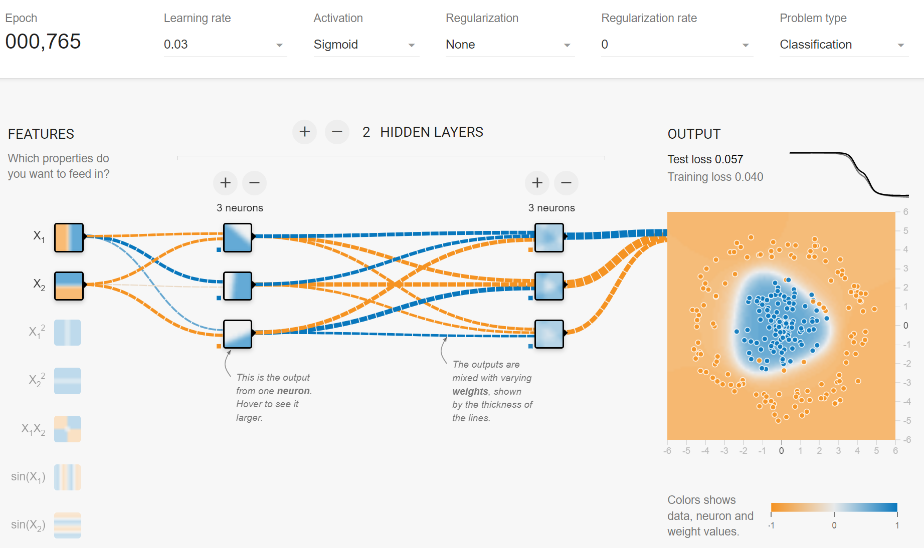
A deep neural network adds many layers to capture complex patterns

Slide 9
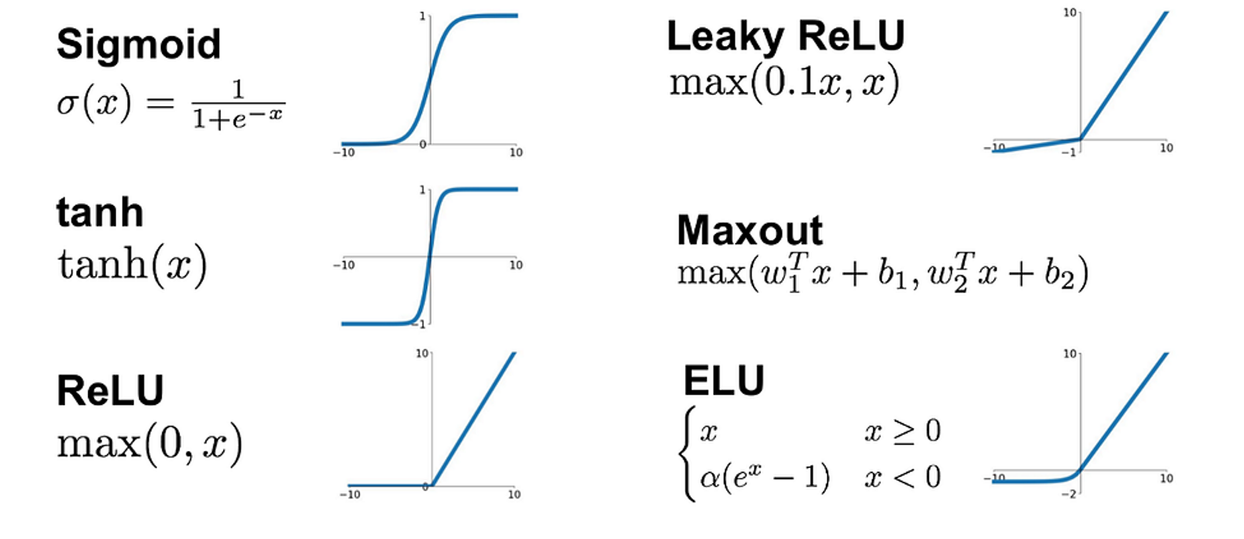
Activation functions can be added on the output of each node
➡️ Capture non-linear relationships
➡️ Avoid exploding or diminishing outputs in deep networks
Notes:
Activation functions are applied to the output of individual nodes. Their role is crucial because they introduce non-linearity. Without them, stacking many layers would still behave like a single linear transformation, and the network would not gain much expressive power.

Slide 10
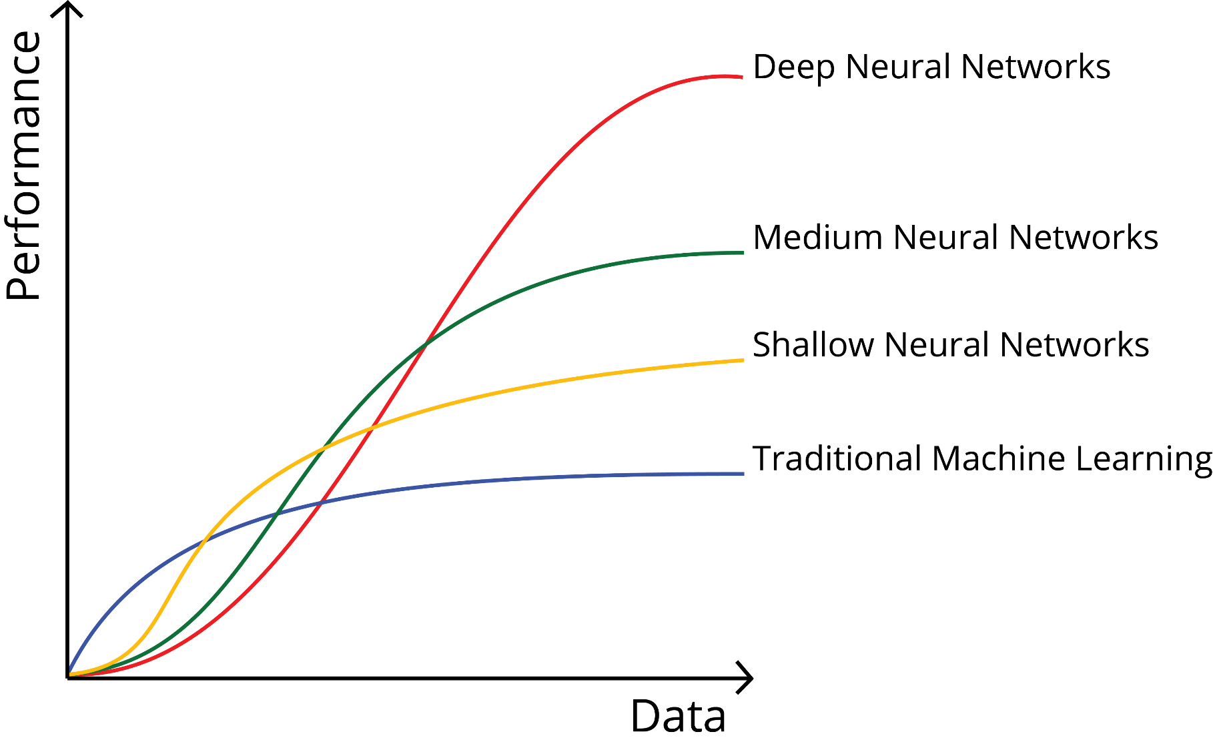
Do we need to go deeper?
Deeper networks…
➡️ … can learn more complex patterns
➡️ … require more data to be trained
Notes:
Do we always need to “go deeper”? The answer is nuanced. Deeper networks can learn more complex patterns, but they also require more training data and computational resources. For smaller datasets or simpler problems, a shallow network or even a traditional machine learning model may be more appropriate.

Slide 11
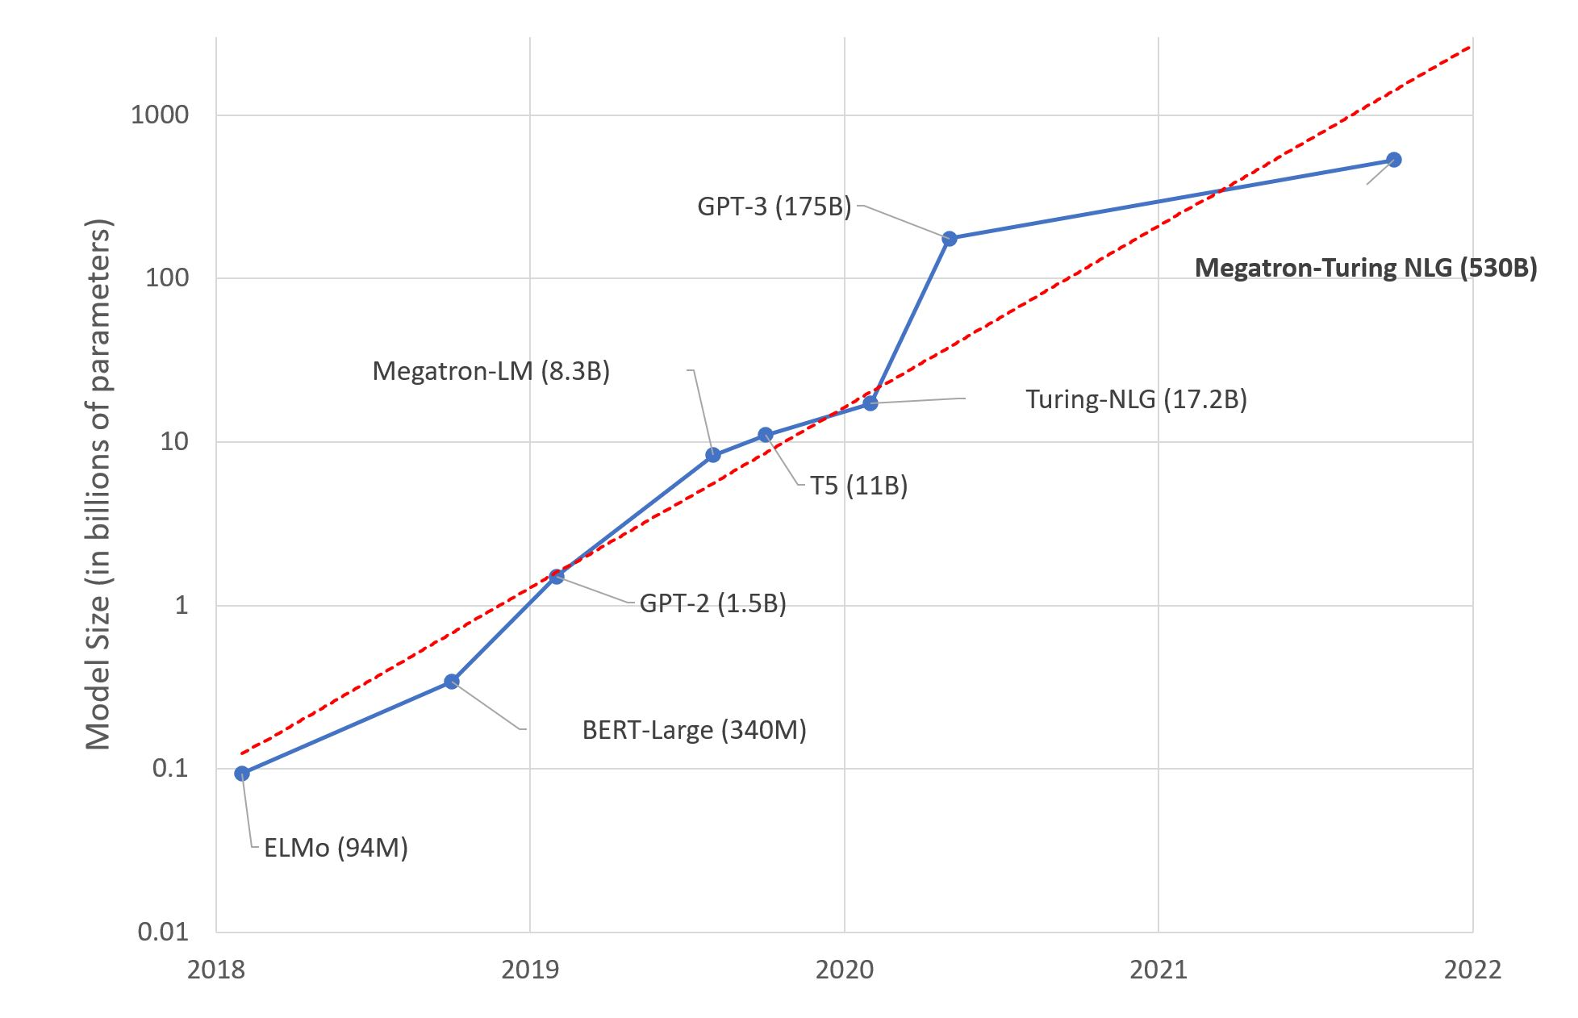
For complex tasks, deeper seems better…
However, more complicated architecture setups are required to make the models learn well.

Slide 12
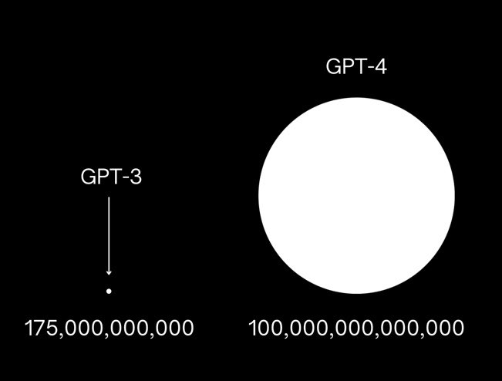
For complex tasks, deeper seems better…
However, more complicated architecture setups are required to make the models learn well.

Slide 13
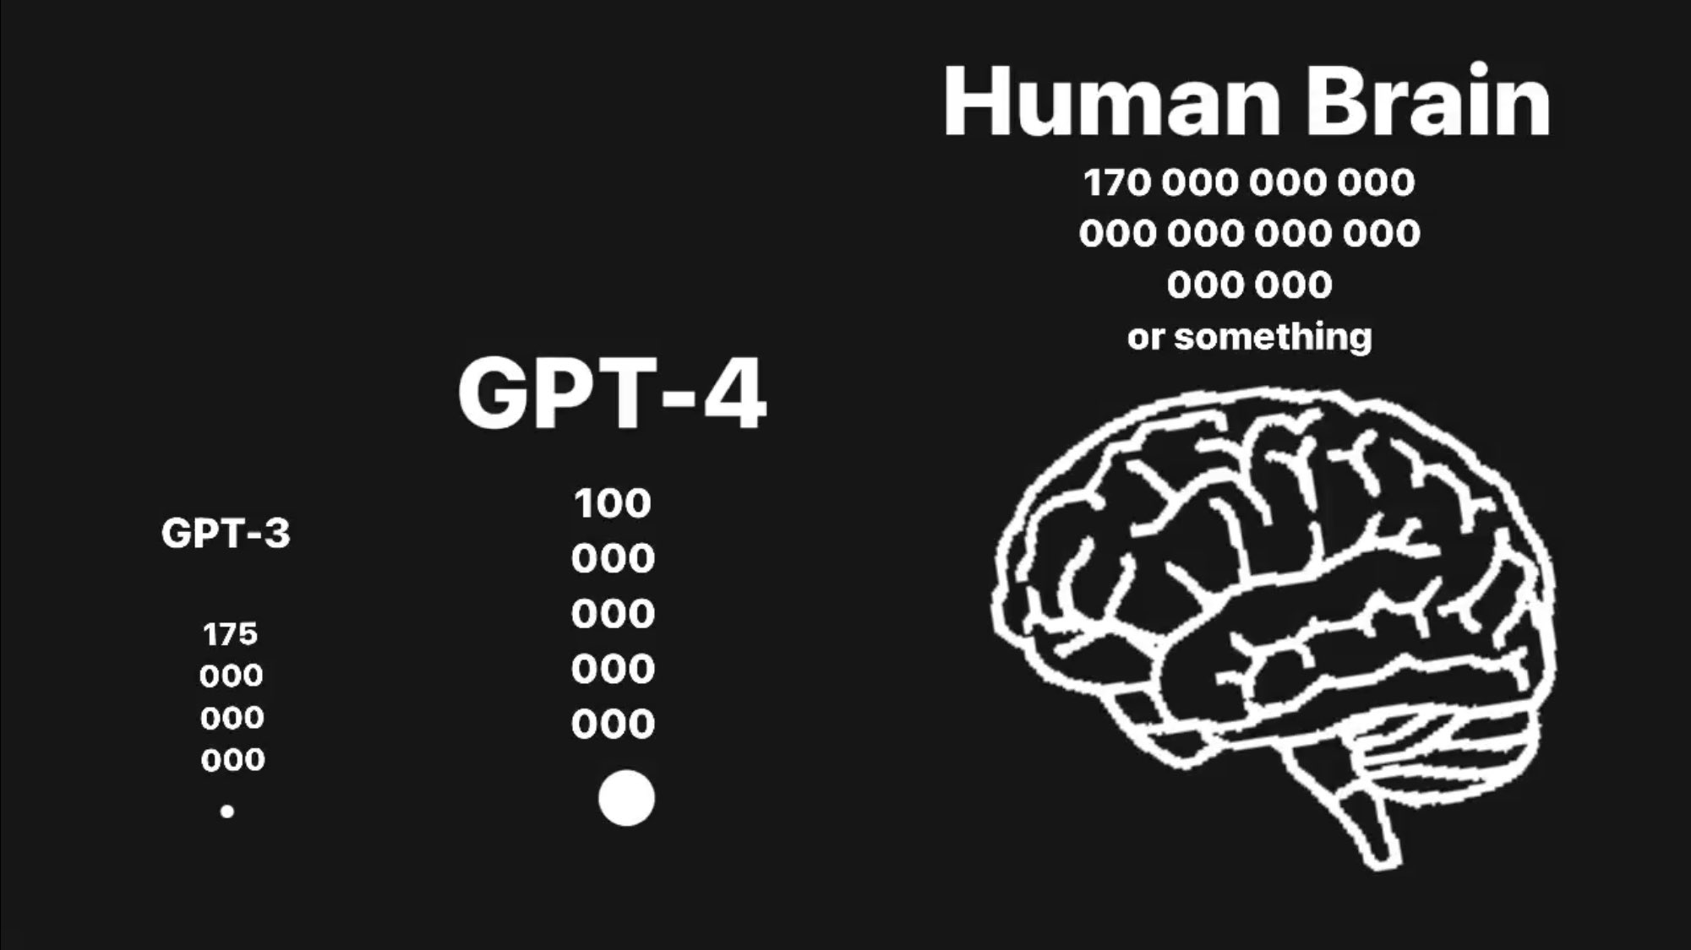
For complex tasks, deeper seems better…
However, more complicated architecture setups are required to make the models learn well.

Slide 14
The loss function should be minimized to find the optimal model
regression
binary classification
multi-class classification
…
➡️
➡️
➡️
➡️
MSE
binary cross entropy
categorical cross entropy
…
Notes:
As in other machine learning models, neural networks are trained by minimizing a loss function. The choice of loss depends on the task. Mean squared error is typical for regression, binary cross-entropy for binary classification, and categorical cross-entropy for multi-class classification. The objective is always the same: find parameter values that make the model’s predictions fit the targets as well as possible.

Slide 15
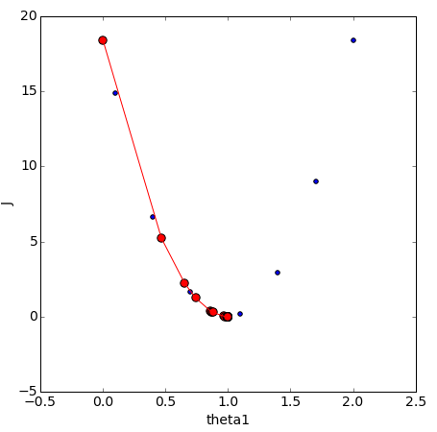
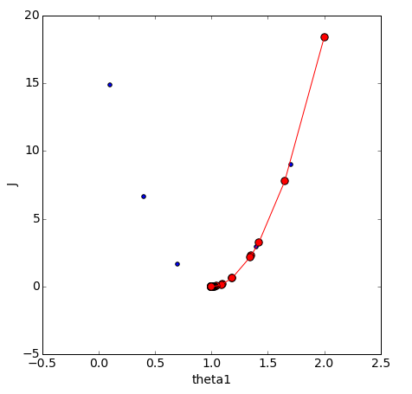
Neural nets also rely on gradient descent to minimize the loss
Iteratively adjusting the weights and biases in the direction that reduces the loss
Notes:
Neural networks are optimized using gradient descent. Training consists of iteratively adjusting weights and biases in the direction that reduces the loss. This is the same core optimization idea already introduced for simpler models, but now applied to a much larger number of parameters.

Slide 16
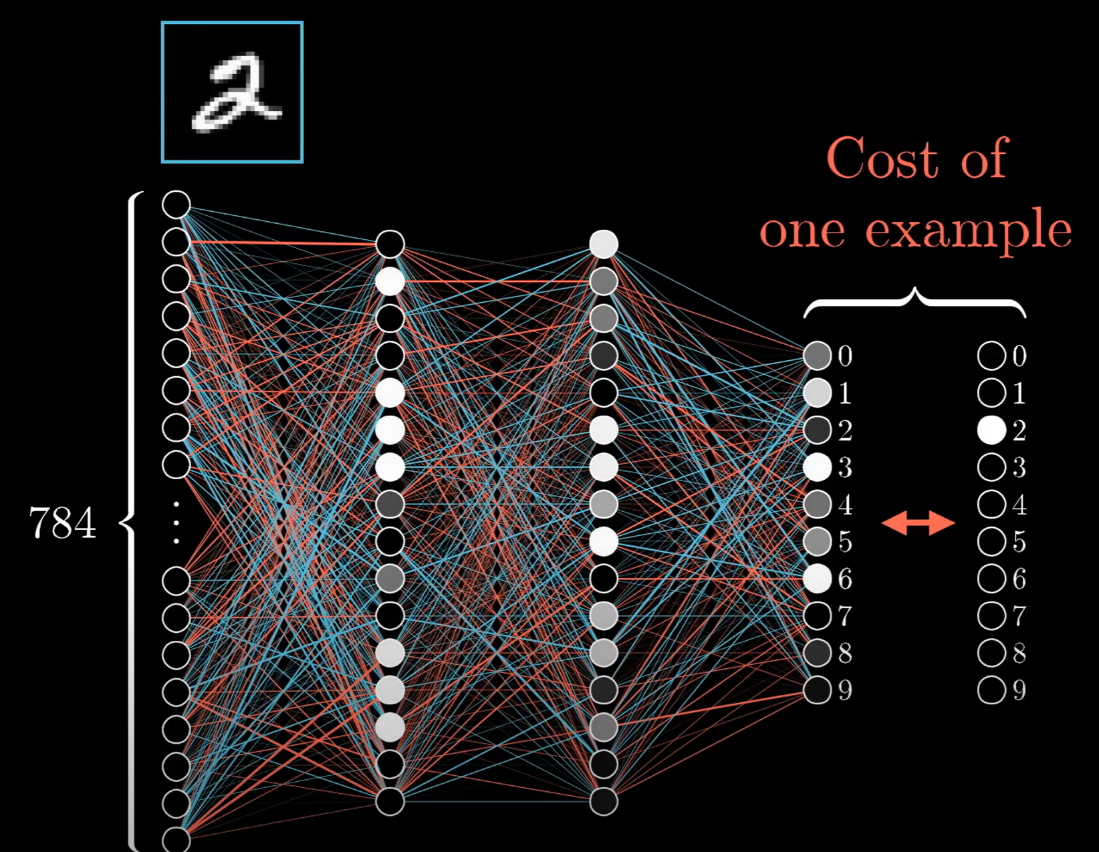
The big trick is to use backpropagation to efficiently calculate gradients for each parameter across many layers
Notes:
The key technical idea that makes neural networks trainable is backpropagation. In a network with many layers and many parameters, directly computing the influence of every parameter on the loss would be inefficient. Backpropagation solves this by propagating error information backward through the network and efficiently calculating gradients for all parameters.
Conceptually, the forward pass computes activations and predictions. The backward pass then determines how each weight and bias contributed to the final error and how it should change to reduce that error. This lets deep models with many layers be trained in practice.

Slide 17
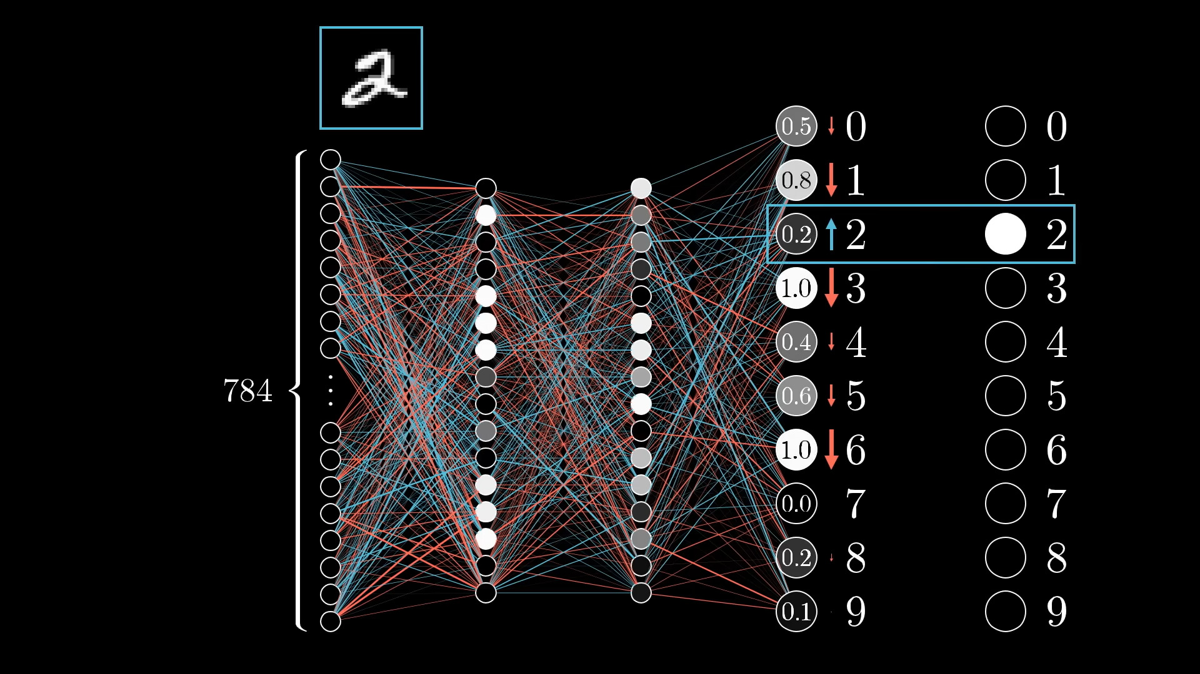
backpropagation
https://youtu.be/Ilg3gGewQ5U?si=hvb1oqZ-GgHn3kl9&t=409

Slide 18
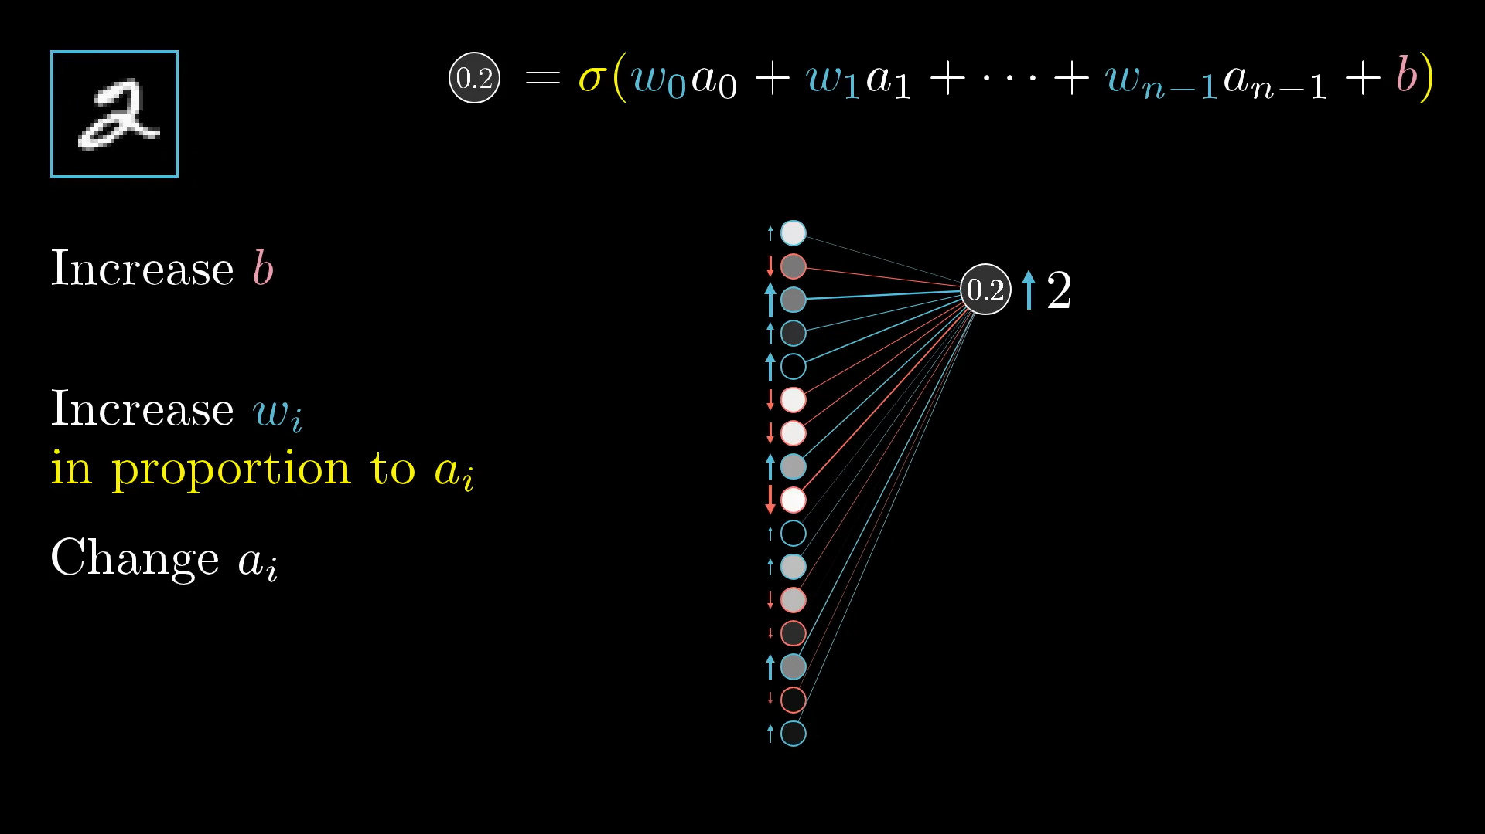
https://youtu.be/Ilg3gGewQ5U?si=hvb1oqZ-GgHn3kl9&t=409

Slide 19
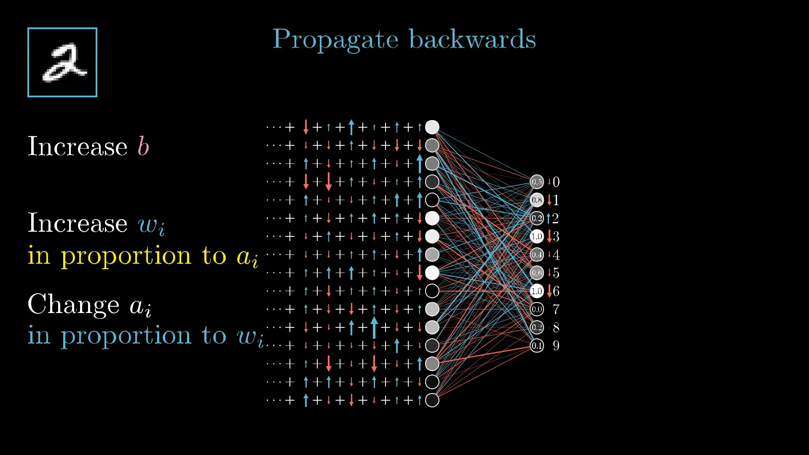
https://youtu.be/Ilg3gGewQ5U?si=hvb1oqZ-GgHn3kl9&t=409

Slide 20
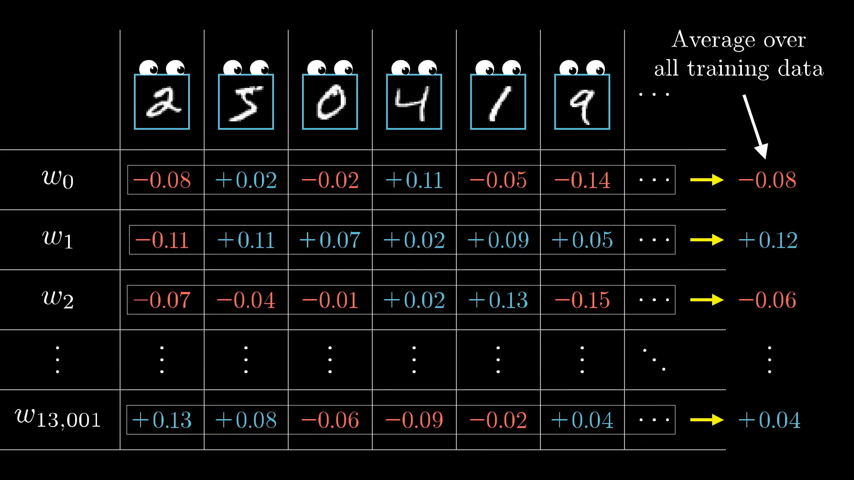
https://youtu.be/Ilg3gGewQ5U?si=hvb1oqZ-GgHn3kl9&t=409

Slide 21
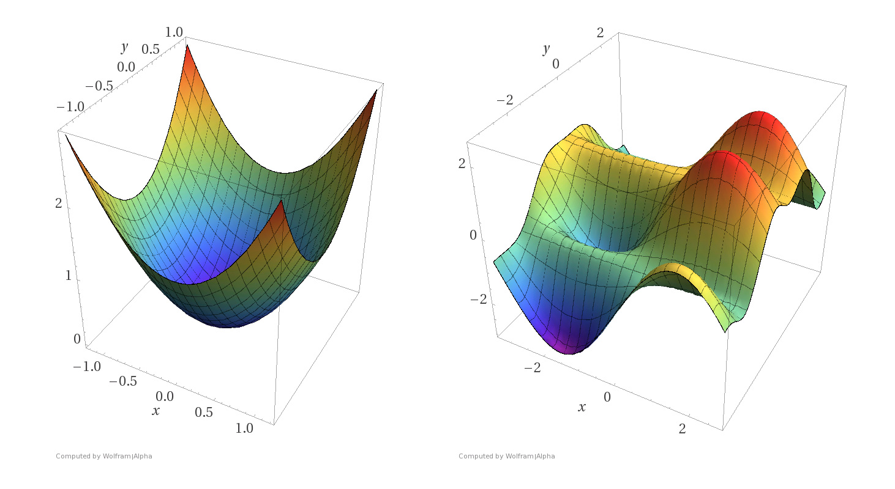
The loss surface can be highly complex, with many local minima
logistic regression (small) neural network
Notes:
For simple models such as logistic regression, the loss surface is often relatively smooth and easy to optimize. For neural networks, especially deep ones, the loss surface becomes much more complex, with many local minima and irregular regions. This makes optimization more difficult and partly explains why training deep networks requires careful design choices.

Slide 22
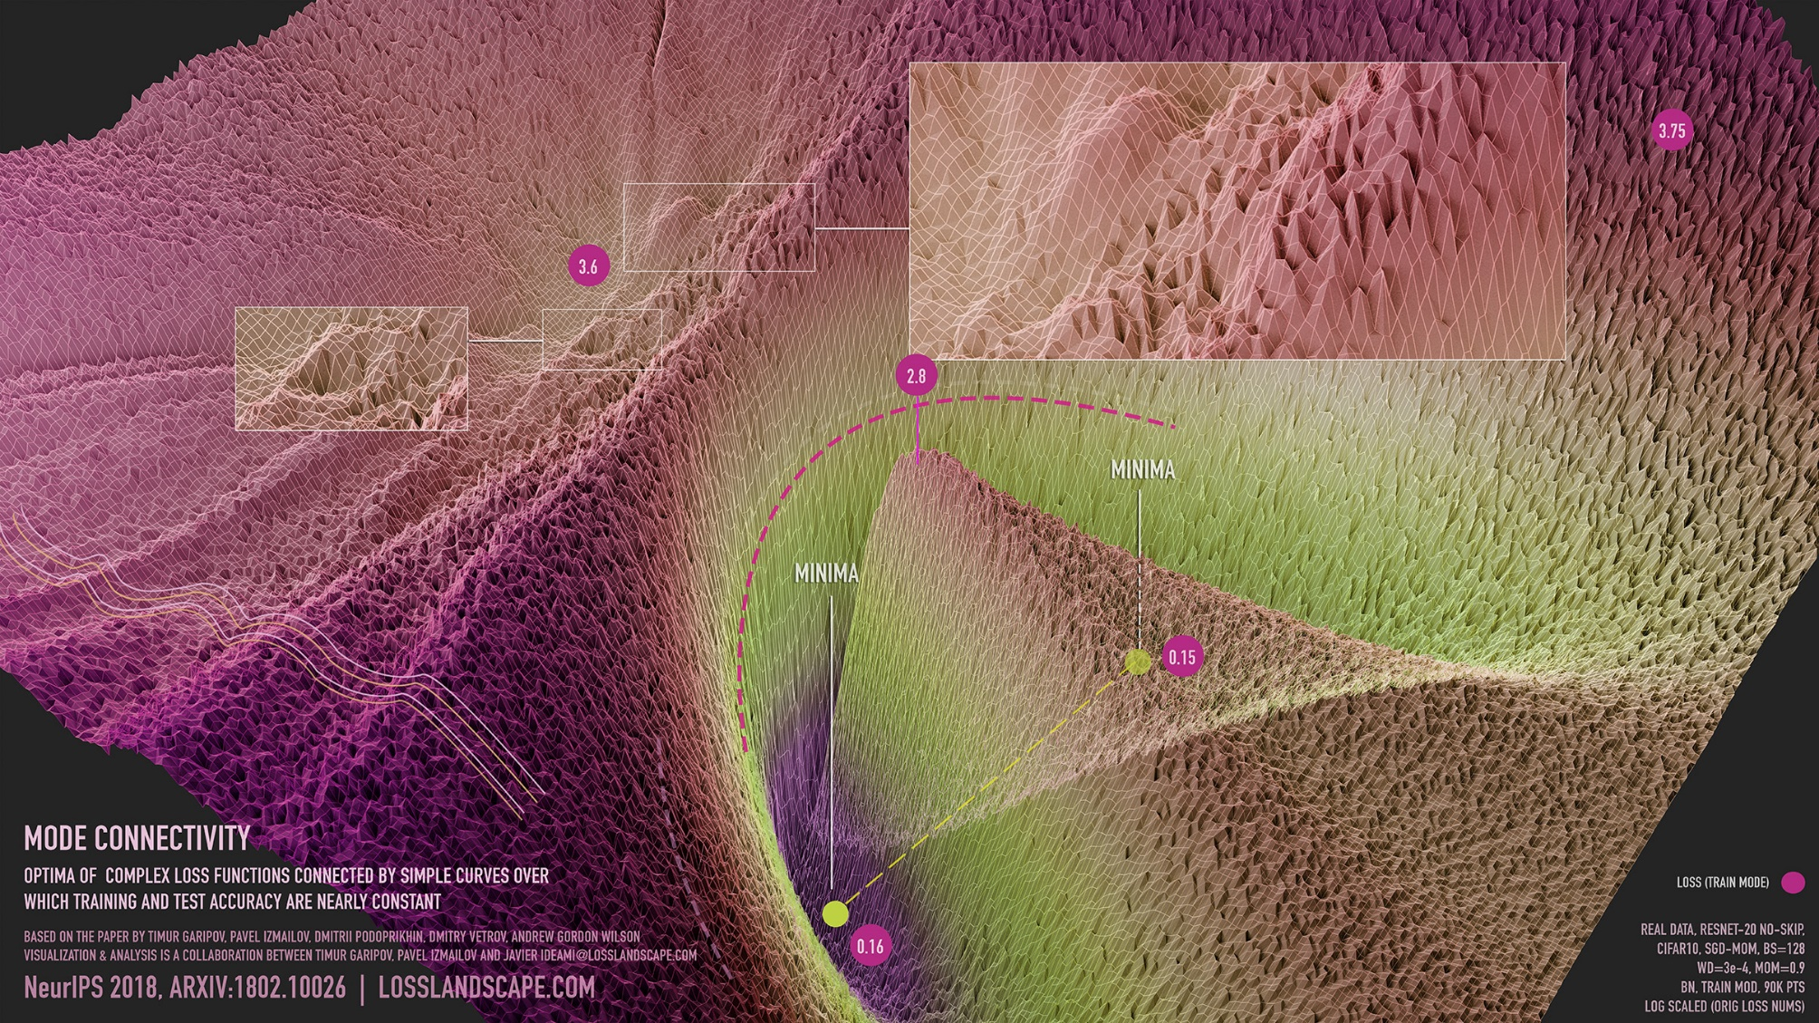
The loss surface can be highly complex, with many local minima
deep neural network

Slide 23
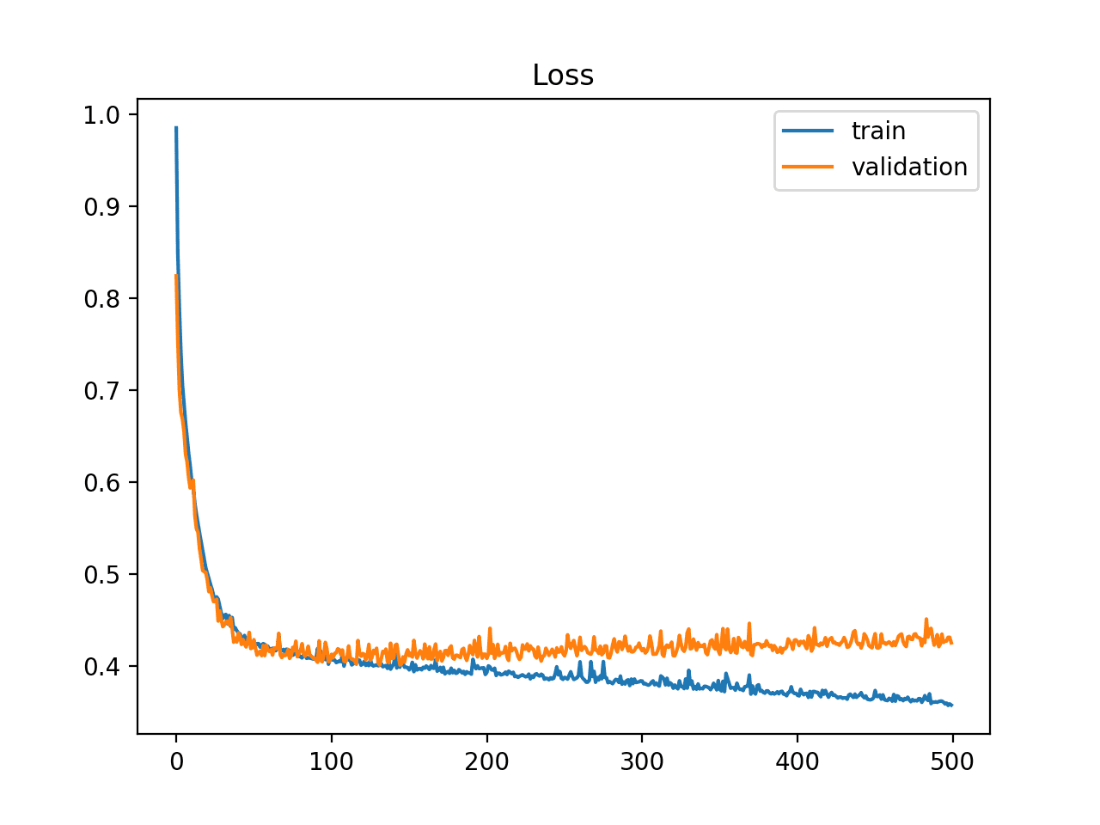
Neural networks are trained over multiple epochs
General training loop
For each epoch
  For each mini-batch (one step)
    Forward pass
    make predictions
    Calculate loss
    compare with targets
    Calculate gradients (aka backward pass)
    how should parameters be updated?
    Update model parameters
  Forward pass on validation data
    Did model improve? Continue.
    Did it stop improving? Stop training.
loss metric (lower is better)
training steps
When should you stop fitting this model?
Notes:
Neural networks are trained over multiple epochs, where one epoch means one full pass through the training data. Within each epoch, the model processes many mini-batches. For each mini-batch, the network performs a forward pass, computes the loss, performs a backward pass to calculate gradients, and then updates the parameters.
After training updates, the model is also evaluated on validation data. If validation performance improves, training can continue. If validation performance stops improving, training should be stopped. This is an example of early stopping, which helps prevent overfitting. The learning-curve figure shows the typical situation where training loss continues to decrease while validation loss eventually stops improving or begins to worsen.

Slide 24
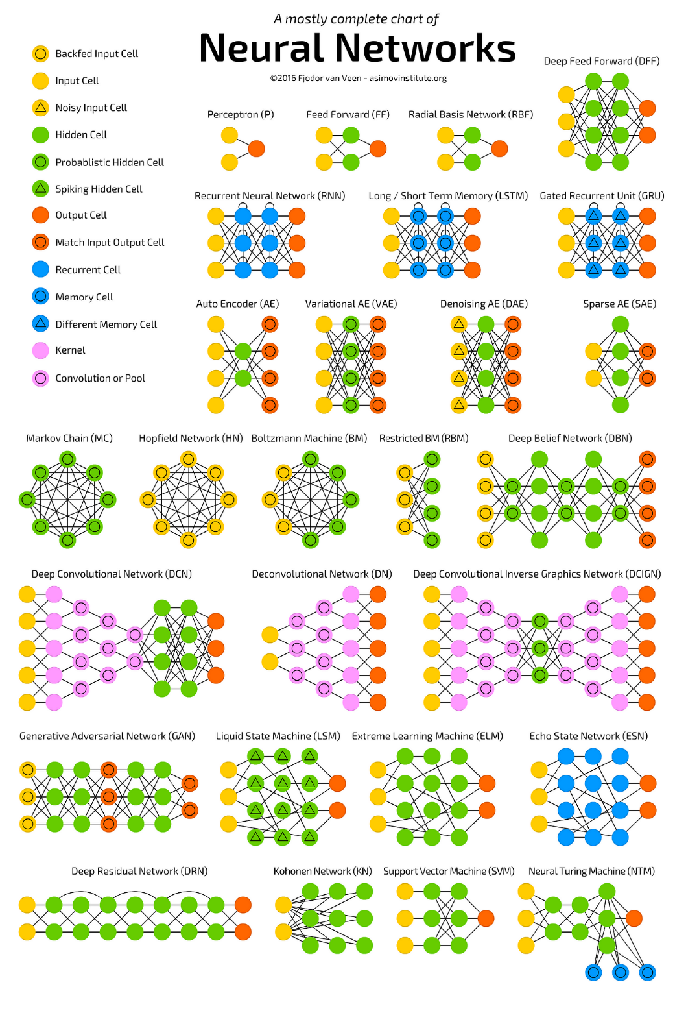
Neural networks are highly flexible
modules == building block == transformation == function
a module receives as input either data 𝑥 or another
module’s output.
a module returns an output based on its activation function
a module may or may not have trainable model parameters.
Notes:
A neural network is best understood as a collection of modules or building blocks. A module takes input, applies some transformation, and returns an output. Some modules have trainable parameters, such as dense layers; others simply transform data without learning parameters, such as certain activation or pooling operations. This modularity is one reason neural networks are highly flexible and can be adapted to many different data types and tasks.

Slide 25
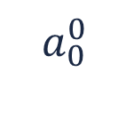
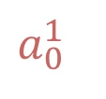


A neural network layer can be represented as a matrix
matrix representation of weights, biases, and activations
$$a_{0}^{0}$$
$$a_{0}^{1}$$
$a_{0}^{1}=σ(w_{0,0}∙a_{0}^{0}+w_{0,1}∙a_{1}^{0}+ …+w_{0,n}∙a_{n}^{0}+b_{0})$
$$a_{1}^{0}$$
$$⋯$$

Slide 26




A neural network layer can be represented as a matrix
matrix representation of weights, biases, and activations
$$a_{0}^{0}$$
$$a_{0}^{1}$$
$a_{0}^{1}=σ(w_{0,0}∙a_{0}^{0}+w_{0,1}∙a_{1}^{0}+ …+w_{0,n}∙a_{n}^{0}+b_{0})$
$$a_{1}^{0}$$
$$a_{1}^{1}$$
$a_{1}^{1}=σ(w_{1,0}∙a_{0}^{0}+w_{1,1}∙a_{1}^{0}+ …+w_{1,n}∙a_{n}^{0}+b_{1})$
$$⋯$$
$$⋯$$
$$…$$
$$a_{k}^{0}$$
$$a_{n}^{1}$$
$a_{n}^{1}=σ(w_{k,0}∙a_{0}^{0}+w_{k,1}∙a_{1}^{0}+ …+w_{k,n}∙a_{n}^{0}+b_{n})$

Slide 27


A neural network layer can be represented as a matrix
matrix representation of weights, biases, and activations
$$a_{0}^{0}$$
$$a_{0}^{1}$$
$a_{0}^{1}=σ(w_{0,0}∙a_{0}^{0}+w_{0,1}∙a_{1}^{0}+ …+w_{0,n}∙a_{n}^{0}+b_{0})$
$$a_{1}^{0}$$
$$a_{1}^{1}$$
$a_{1}^{1}=σ(w_{1,0}∙a_{0}^{0}+w_{1,1}∙a_{1}^{0}+ …+w_{1,n}∙a_{n}^{0}+b_{1})$
$$⋯$$
$$⋯$$
$$…$$
$$a_{k}^{0}$$
$$a_{n}^{1}$$
$a_{n}^{1}=σ(w_{k,0}∙a_{0}^{0}+w_{k,1}∙a_{1}^{0}+ …+w_{k,n}∙a_{n}^{0}+b_{n})$
$$\left[\begin{matrix}a_{0}^{1} \\ a_{1}^{1} \\ ⋮ \\ a_{n}^{1}\end{matrix}\right]=σ\left(\left[\begin{matrix}w_{0,0} & w_{0,1} & ⋯ & w_{0,n} \\ w_{1,0} & w_{1,1} & ⋯ & w_{1,n} \\ ⋮ & ⋮ & ⋱ & ⋮ \\ w_{k,0} & w_{k,1} & ⋯ & w_{k,n}\end{matrix}\right]\left[\begin{matrix}a_{0}^{0} \\ a_{1}^{0} \\ ⋮ \\ a_{n}^{0}\end{matrix}\right]+\left[\begin{matrix}b_{0} \\ b_{1} \\ ⋮ \\ b_{n}\end{matrix}\right] \right)$$
$$a^{1}=σ(W^{1}∙a^{0}+b^{1})$$
Notes:
A full layer of a neural network can be written compactly in matrix form. Instead of writing one equation per neuron, all neuron computations in a layer can be grouped into a matrix multiplication plus a bias vector, followed by an activation function.

Slide 28

Notes:
Because neural network computations rely heavily on large matrix operations, GPUs are highly effective for training them. GPUs are designed for parallel numerical computation and therefore accelerate both the forward and backward passes, especially in deep models with many parameters.

Slide 29
Recap
Neural networks can be understood as layered stacks of logistic-regression-like units.
They can learn non-linear patterns through activation functions.
Deeper networks can learn more complex patterns, but require more data.
Backpropagation allows for gradient descent across many neural network layers.
Mini-batch gradient descent balances speed and stability.
Neural networks can be trained over many epochs.

